Slide 1
Sequence to Sequence Image Generation (Video Prediction)
Shuliang Ning
The Chinese University of Hong Kong, Shenzhen
115010206@link.cuhk.edu.cn
Sep. 9th, 2019

Slide 2
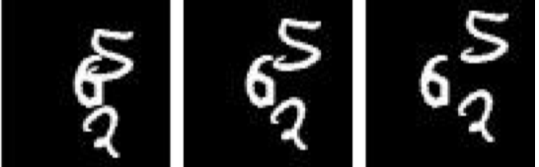
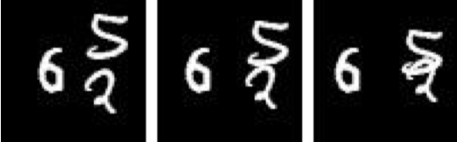
Task: Sequence to Sequence Image Generation
Problem formulation: Encoder-Decoder
Case: weather nowcasting, traffic flows prediction
Input: Image Sequence
Eecoder
Decoder
Output: Image Sequence

Slide 3
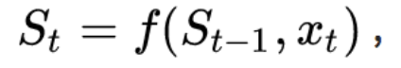
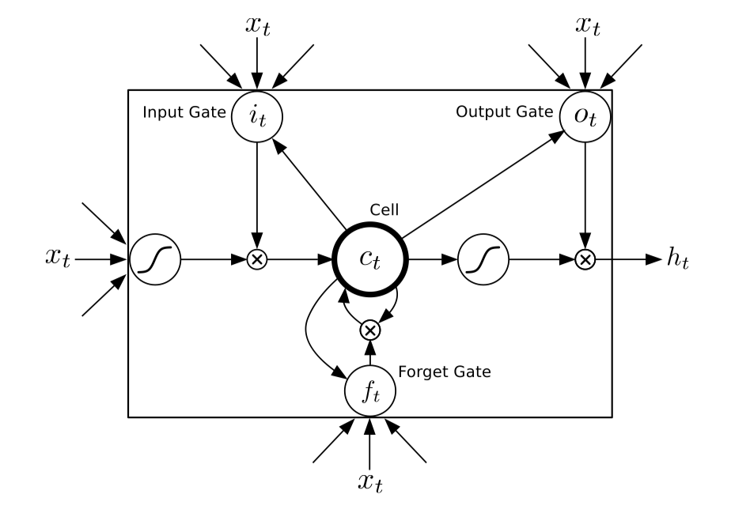
The advantage of LSTM
Solve the problem of gradient vanish.
Conventional RNN:
Long Short Term Memory
Notes:
Three sigmoidal gates to control the memory uint.

Slide 4

Exsiting works: FC-LSTM(ICML 2015)
Unsupervised Learning of Video Representations using LSTMs
Notes:
Input is Image patch, output same 输入和输出 相同sequence 但是顺序相反 完全学一个镜像

Slide 5
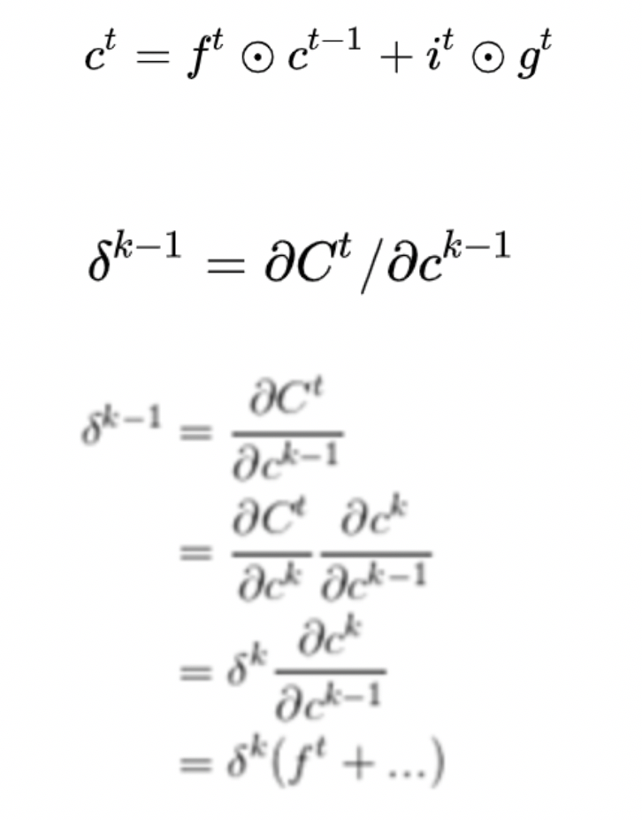
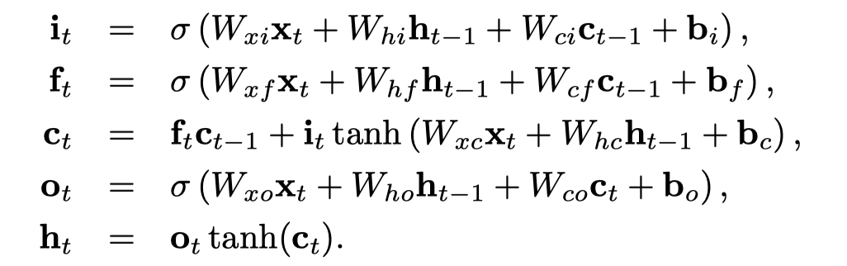
FC-LSTM
What’s the meaning of unsupervise learning?
Use Ground Truth
No labels.
The updates for a layer of LSTM units
Cell state in an LSTM unit sums activities over time. Since derivatives distribute over sums, the error derivatives don’t vanish quickly as they get sent back into time.
Notes:
cell state in an LSTM unit sums activities over time. Since derivatives distribute over sums, the error derivatives don’t vanish quickly as they get sent back into time.

Slide 6
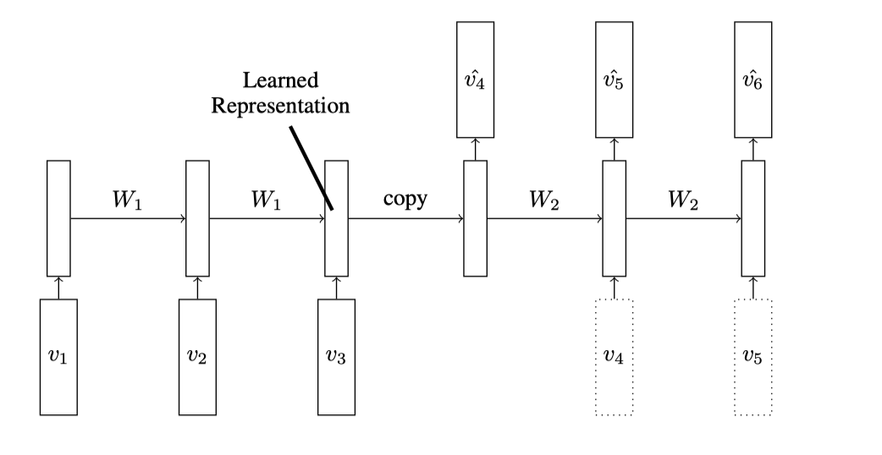
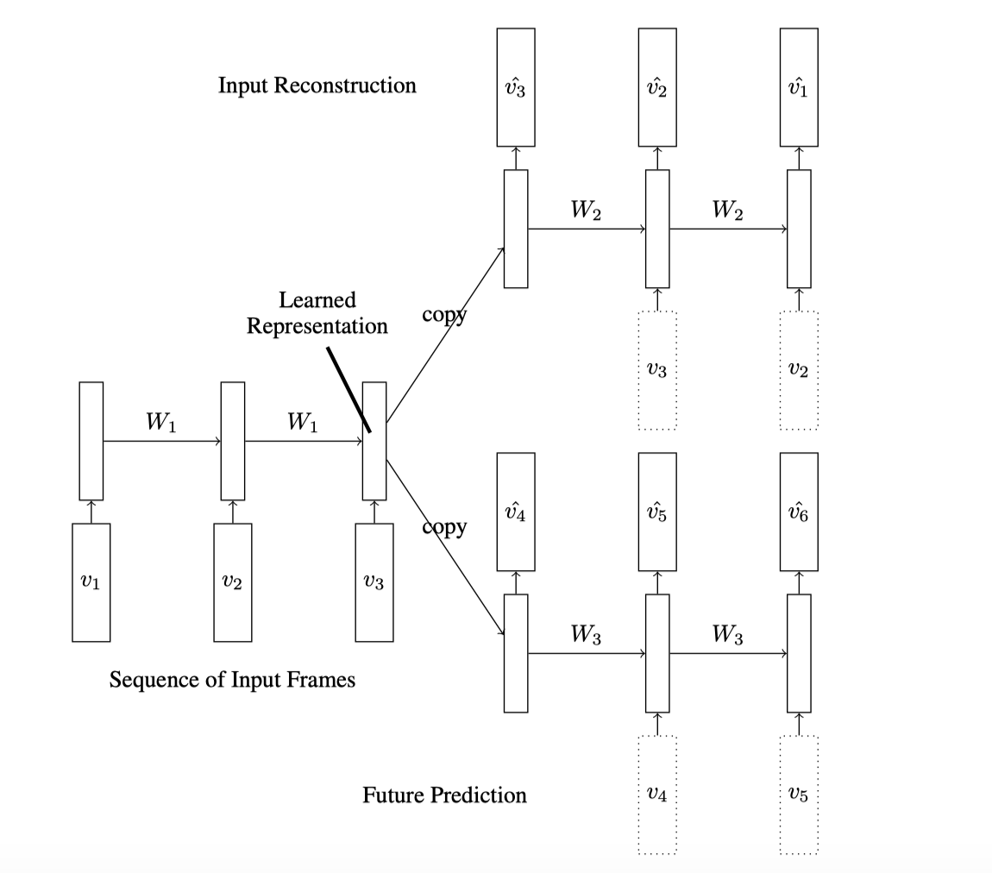
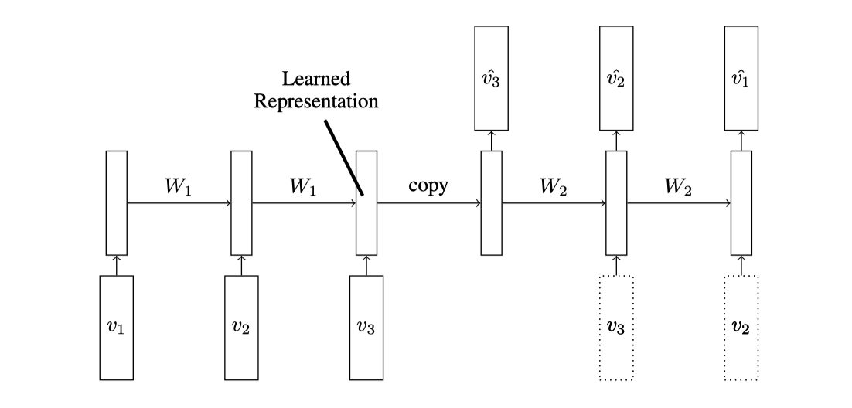
Model
Input: A sequence of vectors (image patches or features)
Notes:
有两个实验，一个是预测相同的input sequence， 一个是生成future sequence， 基于大背景，前面的就不提了，网络架构也差不多。
虚线框起来的是有上一帧作为输入或者没有。
基于最有一张，composite 能够更好地记忆效果

Slide 7
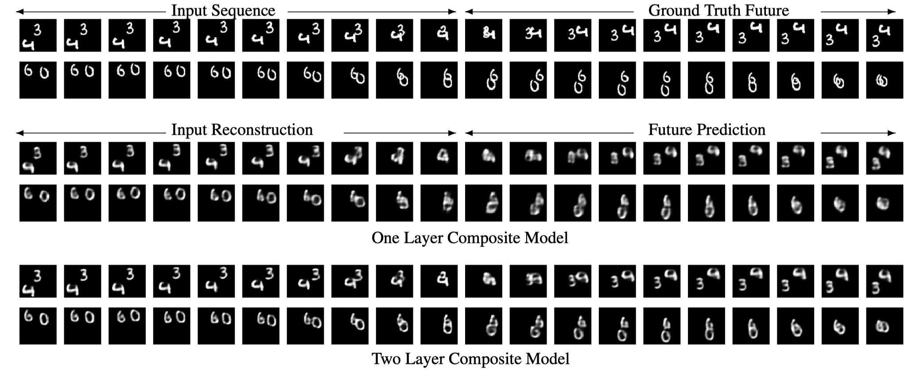
Experiments
Notes:
We can see that adding depth helps the model make better predictions.

Slide 8
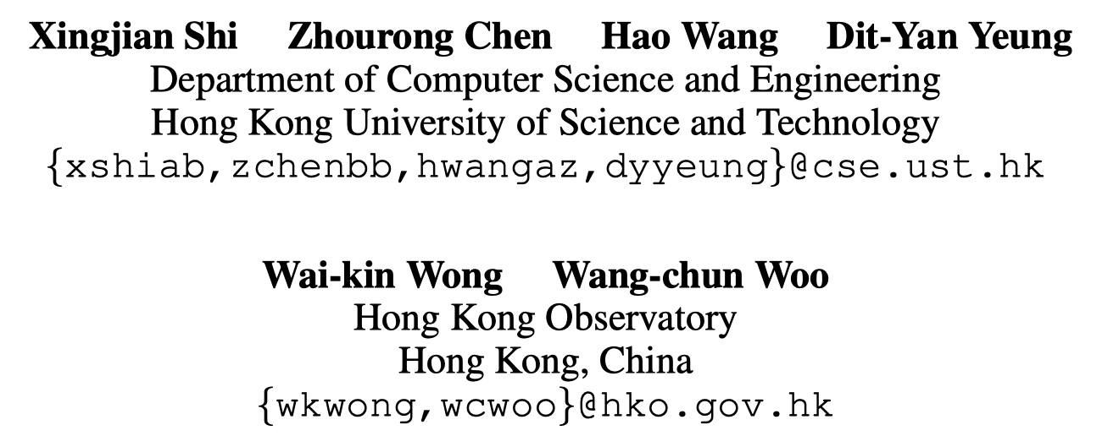
Exsiting works: Conv-LSTM(NIPS 2015)
Convolutional LSTM Network: A Machine Learning Approach for Precipitation Nowcasting
Notes:
Input is Image patch, output same 输入和输出 相同sequence 但是顺序相反 完全学一个镜像

Slide 9
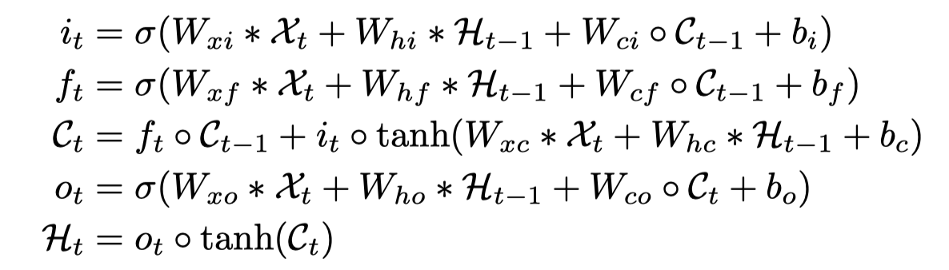
Conv-LSTM
Disadvantage of FC-LSTM: No spatial correlation.
Formulate precipitation nowcasting as a spatiotemporal sequence forecasting problem.
The updates for a layer of LSTM units

Slide 10
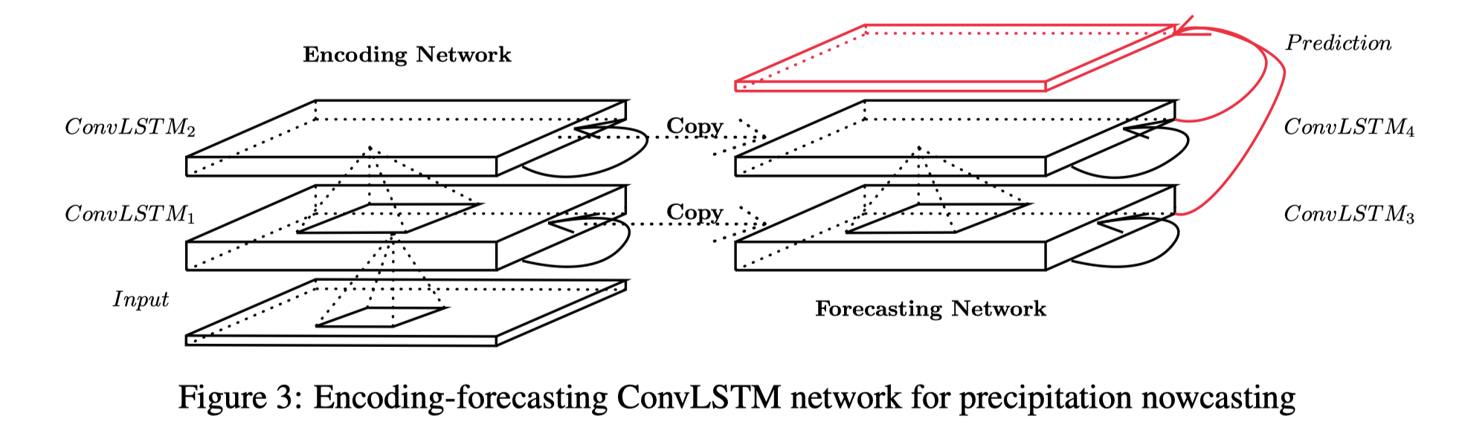
Model
Input: three-dimensional tensors
Notes:
the initial states of the forecasting network are copied from the last state of the encoding network.
最后1*1 卷积 得到final prediction
Deeper models can produce better results with fewer parameters.

Slide 11
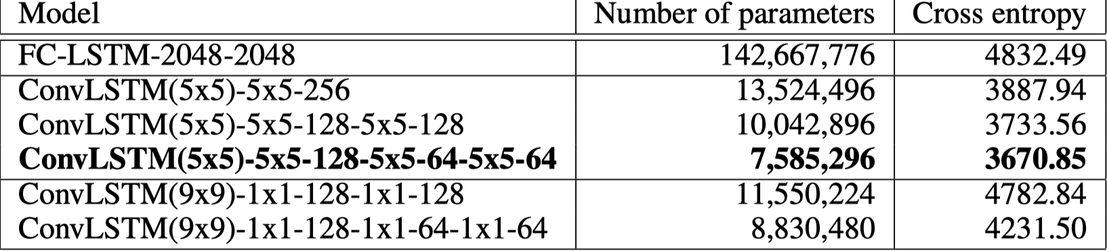
Experiments
Data set: Moving MNIST
Input & Output: 10 frames to 10 frames
Deeper model gives better results, large kernel size can capture spatiotemporal correlations.
Notes:
the initial states of the forecasting network are copied from the last state of the encoding network.
最后1*1 卷积 得到final prediction
-5x5’ and ‘-1x1’ represent the corresponding state-to-state kernel size, which is either 5×5 or 1×1. ‘256’, ‘128’, and ‘64’ refer to the number of hidden states in the ConvLSTM layers. ‘(5x5)’ and ‘(9x9)’ represent the input-to-state kernel size.

Slide 12
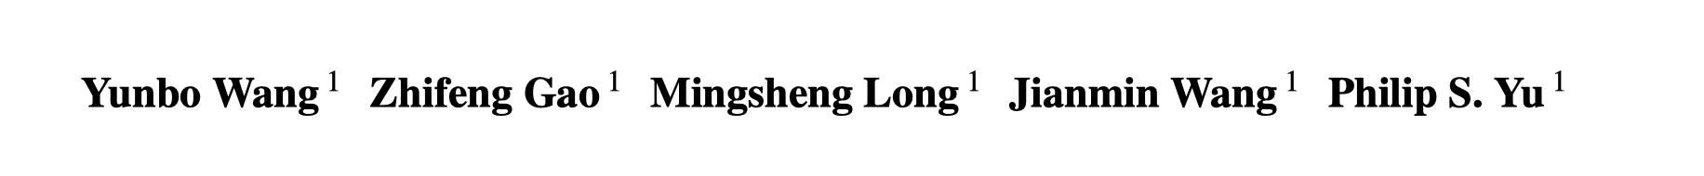
Exsiting works: PredRNN++(ICML 2018)
PredRNN++: Towards A Resolution of the Deep-in-Time Dilemma in Spatiotemporal Predictive Learning
Notes:
Input is Image patch, output same 输入和输出 相同sequence 但是顺序相反 完全学一个镜像

Slide 13
Contribution
Causal LSTM
Gradient Highway Unit (GHU)
Increasing the step-to-step transition depth in ConvLSTMs can signiﬁcantly improve its modeling capability to the short-term dynamics.
Notes:
Input is Image patch, output same 输入和输出 相同sequence 但是顺序相反 完全学一个镜像

Slide 14
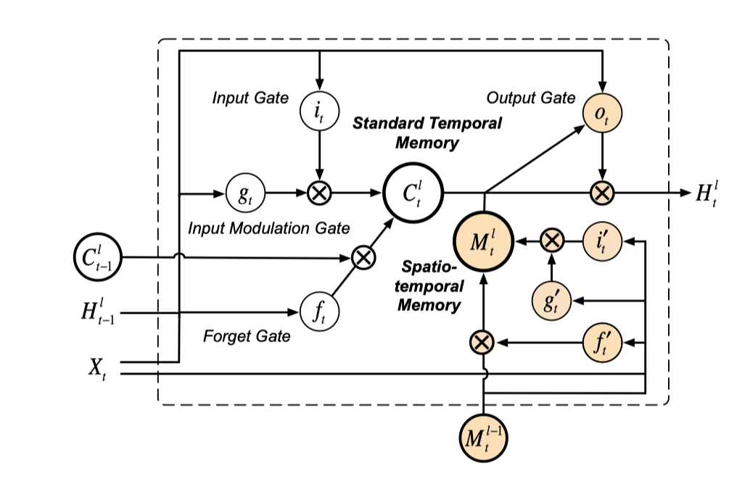
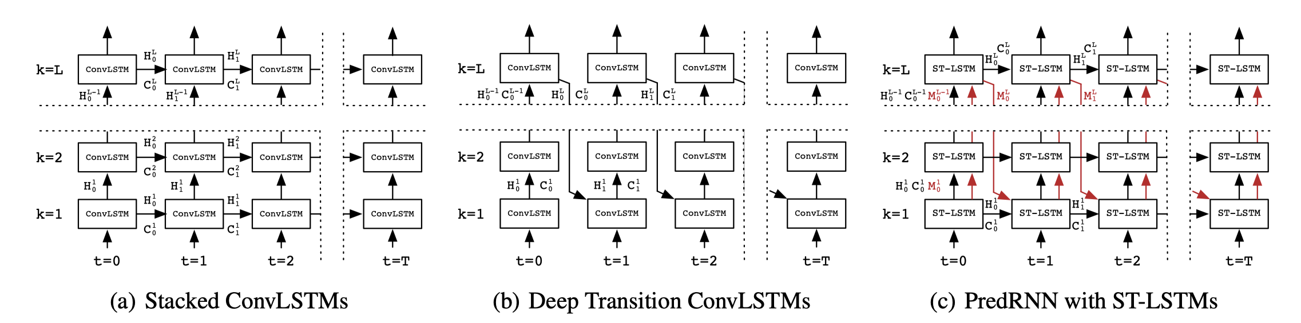
Review Three LSTMS
PredRNN: Combine first two, add a dual memory mechanism
Notes:
Dual memory mechanism: a simple concatenation with gates, the horizontally updated temporal memory C with the vertically transformed spatial memory M.
Then concat+1*1 convolution
long-term coherence
short term recurrence depth

Slide 15
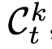
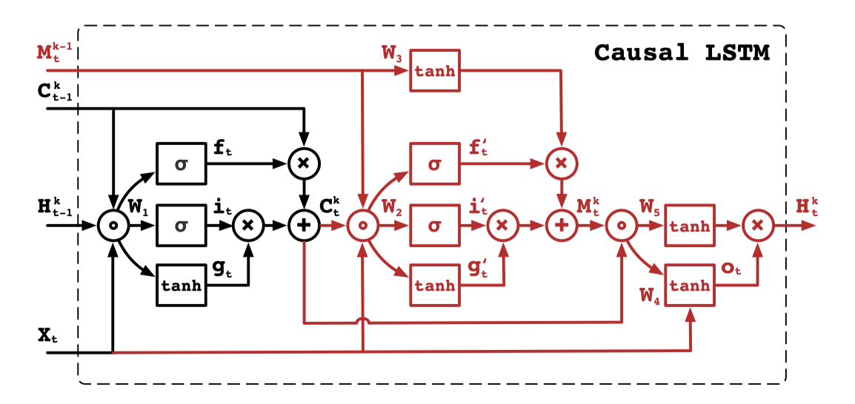
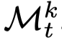
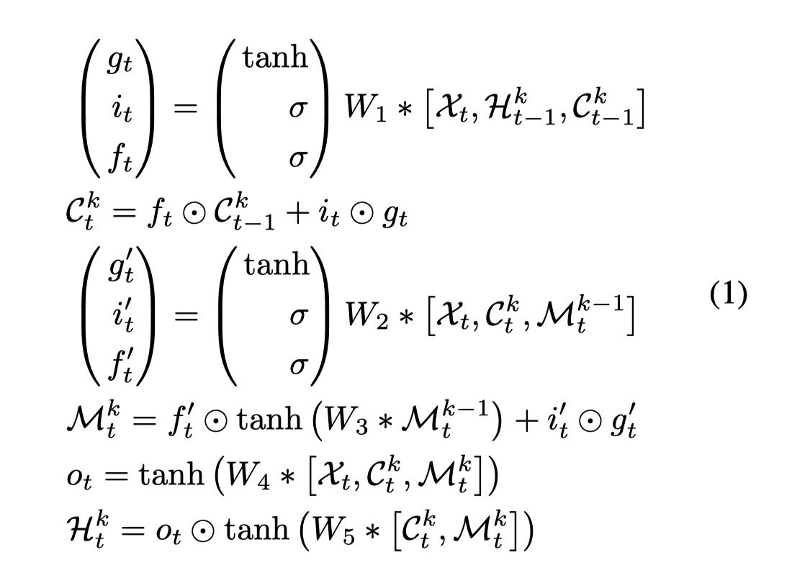
Causal LSTM:
Add more non-linear layers to recurrent transitions, increasing the network depth from one state to the next.
Temporal memory
Spatial memory
Notes:
Dual memory mechanism: a simple concatenation with gates, the horizontally updated temporal memory C with the vertically transformed spatial memory M.
Then concat+1*1 convolution
改变： PredRNN 直接concat 到一起，但是这个是 红色部分 不一样

Slide 16
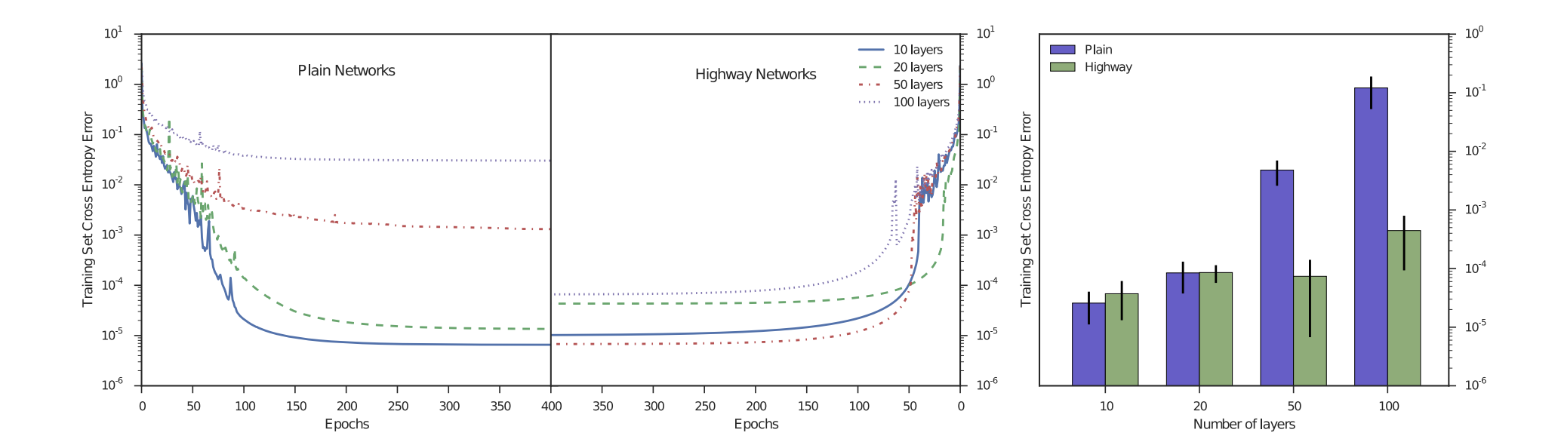
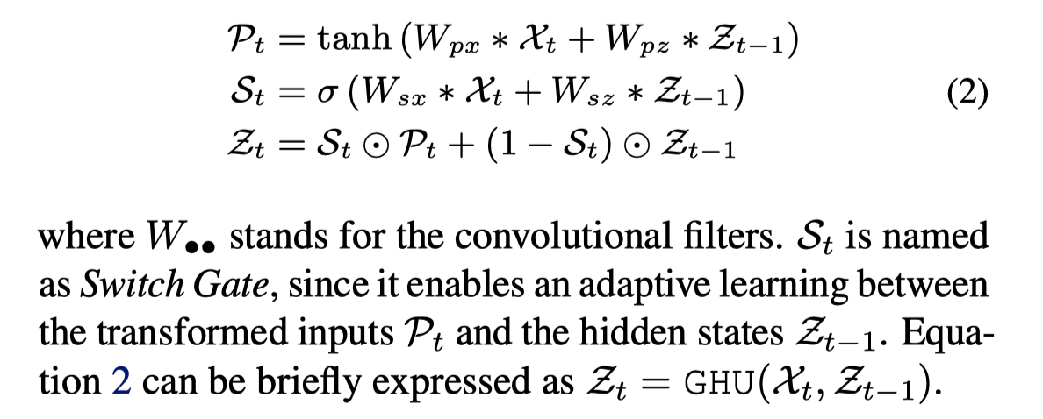
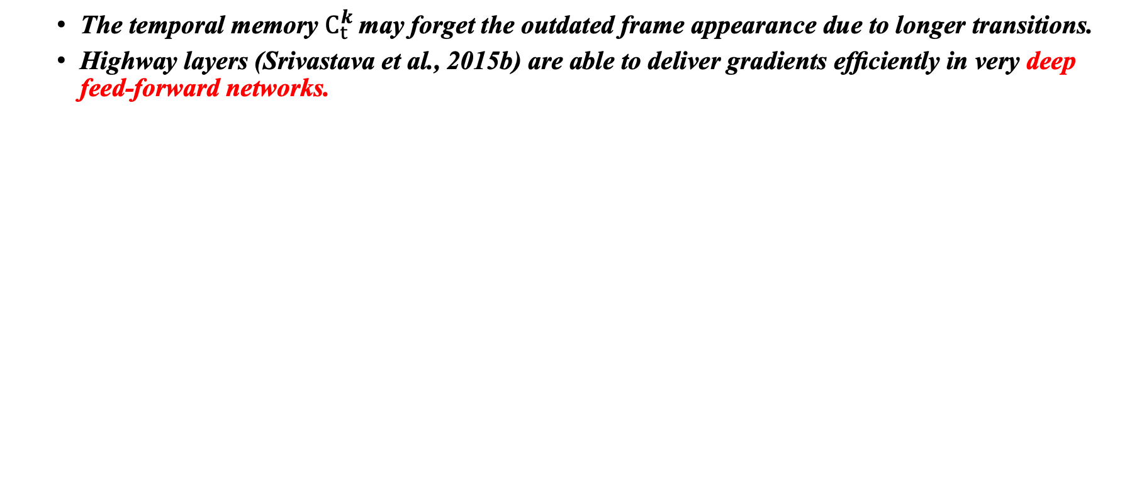
Gradient Highway Unit (GHU)
The temporal memory $C_{t}^{k}$may forget the outdated frame appearance due to longer transitions.
Highway layers (Srivastava et al., 2015b) are able to deliver gradients efﬁciently in very deep feed-forward networks.
Notes:
In particular, the temporal memory C t k may forget the outdated frame appearance due to longer transitions.
Need GHU to learn skip-frame relations.

Slide 17
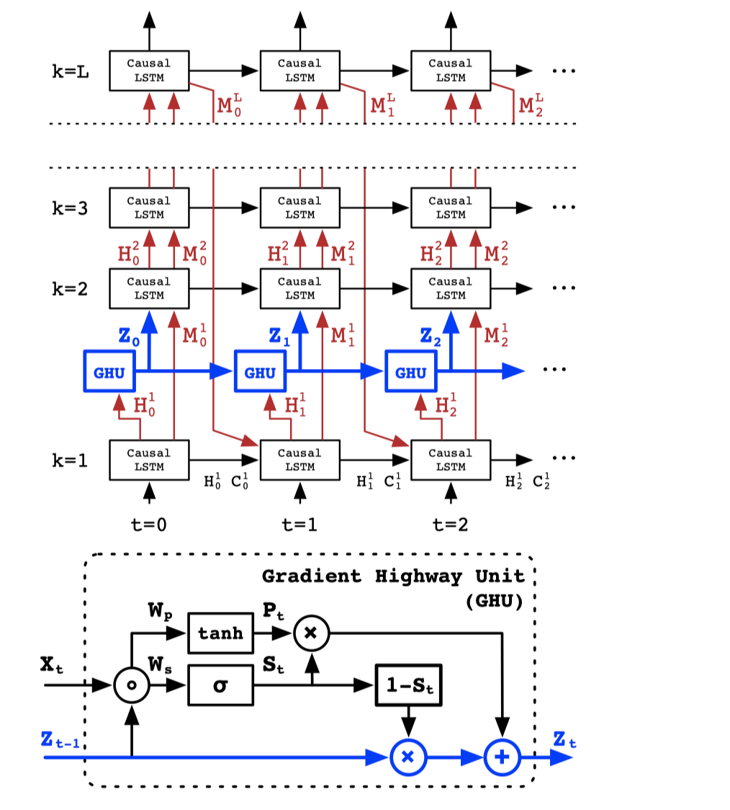
Causal LSTM & GHU
Notes:
But unlike temporal skip connections, it controls the proportions of Z t−1 and the deep transition fea1tures H t through the switch gate S t , enabling an adaptive learning of the long-term and the short-term frame relations.

Slide 18
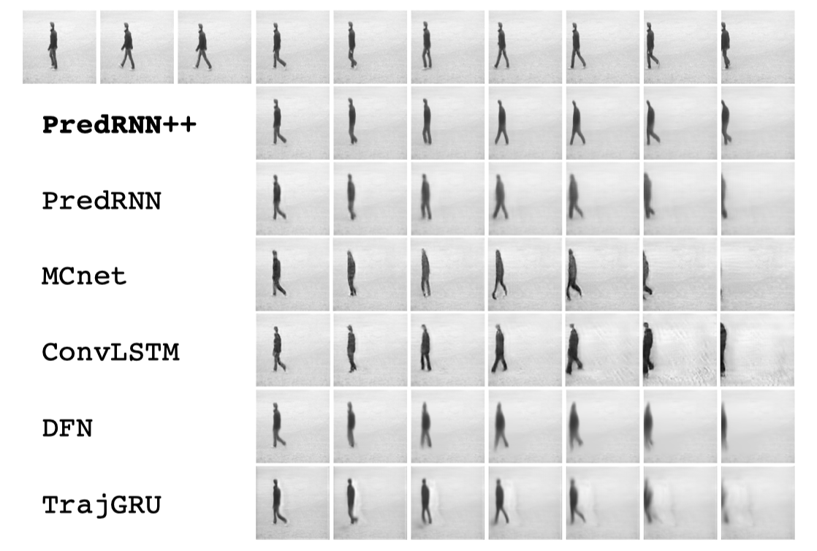
Experiments
Notes:
But unlike temporal skip connections, it controls the proportions of Z t−1 and the deep transition fea1 tures H t through the switch gate S t , enabling an adaptive learning of the long-term and the short-term frame relations.

Slide 19
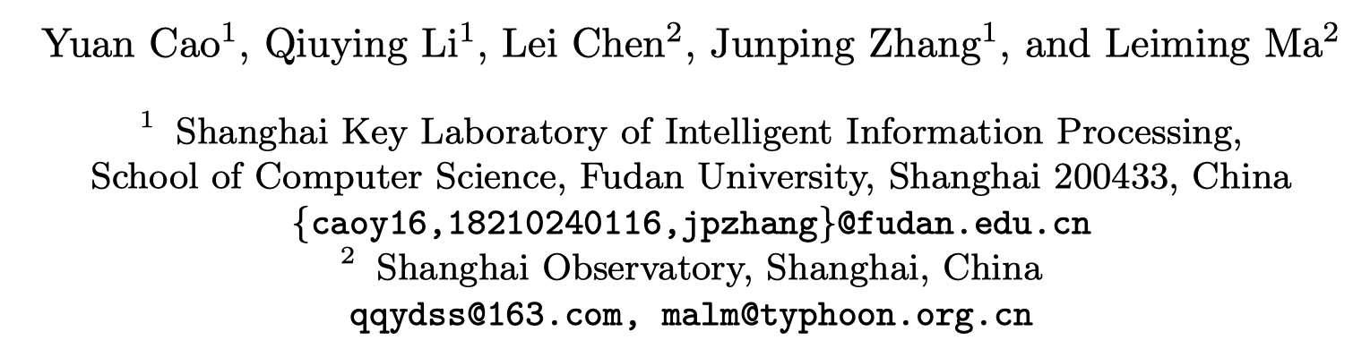
Video Prediction for Precipitation Nowcasting
Notes:
the initial states and cell outputs of the forecasting network are copied from the last state of the encoding network.
最后1*1 卷积 得到final prediction
-5x5’ and ‘-1x1’ represent the corresponding state-to-state kernel size, which is either 5×5 or 1×1. ‘256’, ‘128’, and ‘64’ refer to the number of hidden states in the ConvLSTM layers. ‘(5x5)’ and ‘(9x9)’ represent the input-to-state kernel size.

Slide 20
Contribution:
Propose an eﬀective star-shape information bridge for recurrent network.
Propose a new multi sigmoid loss for precipitation nowcasting task.

Slide 21
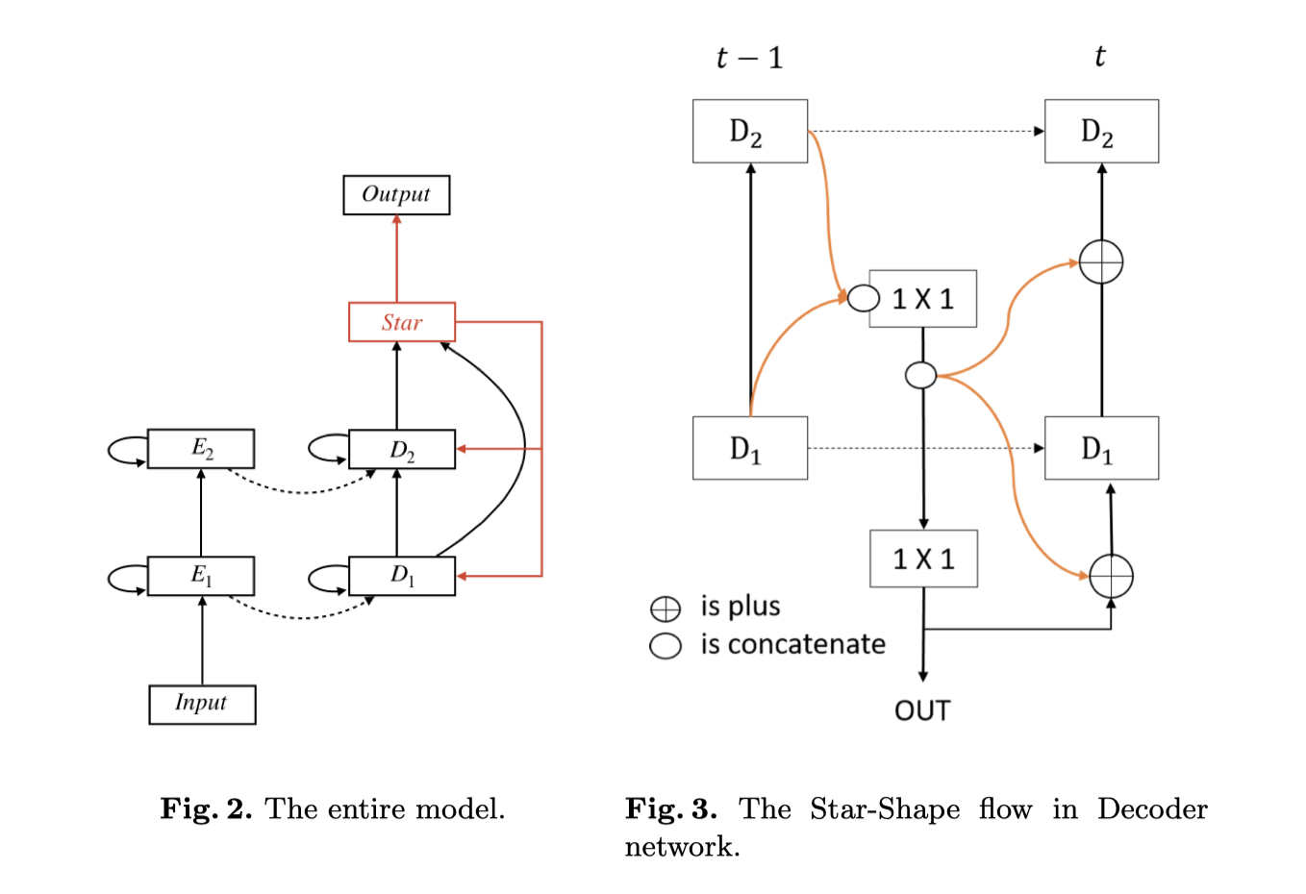
Star-shape Information Bridge
Concatenate
1 × 1 convolution
residual connection
Notes:
concatenate output of all ConvLSTM layers and pass it to a 1 × 1 convolution layer and split the output of convolution layer to all ConvLSTM layers of next time-step by a residual connection to their inputs

Slide 22
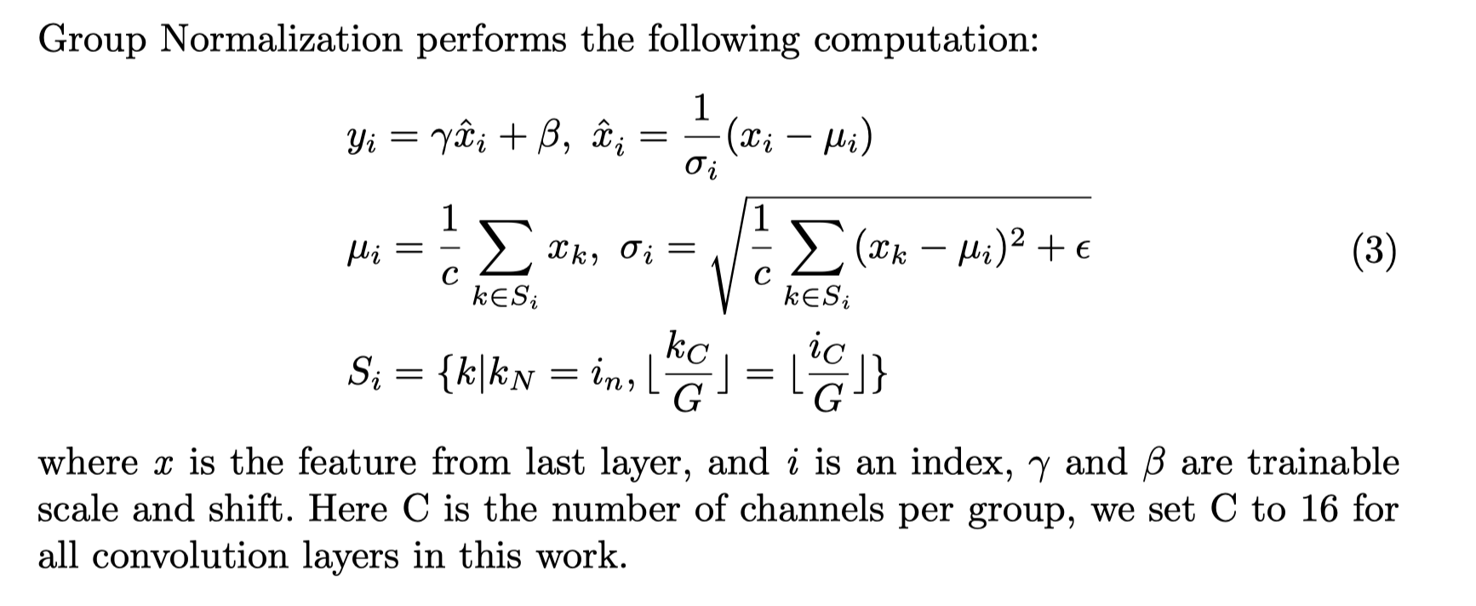
Group Normalization
High resolution image training, usually the batch size is small, so batch normalization is restricted.
Notes:
concatenate output of all ConvLSTM layers and pass it to a 1 × 1 convolution layer and split the output of convolution layer to all ConvLSTM layers of next time-step by a residual connection to their inputs

Slide 23
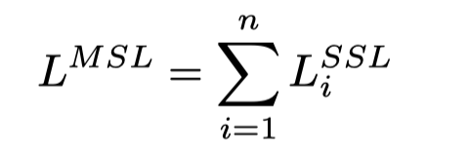
Multi-Sigmoid Loss for Precipitation Nowcasting
Notes:
concatenate output of all ConvLSTM layers and pass it to a 1 × 1 convolution layer and split the output of convolution layer to all ConvLSTM layers of next time-step by a residual connection to their inputs

Slide 24
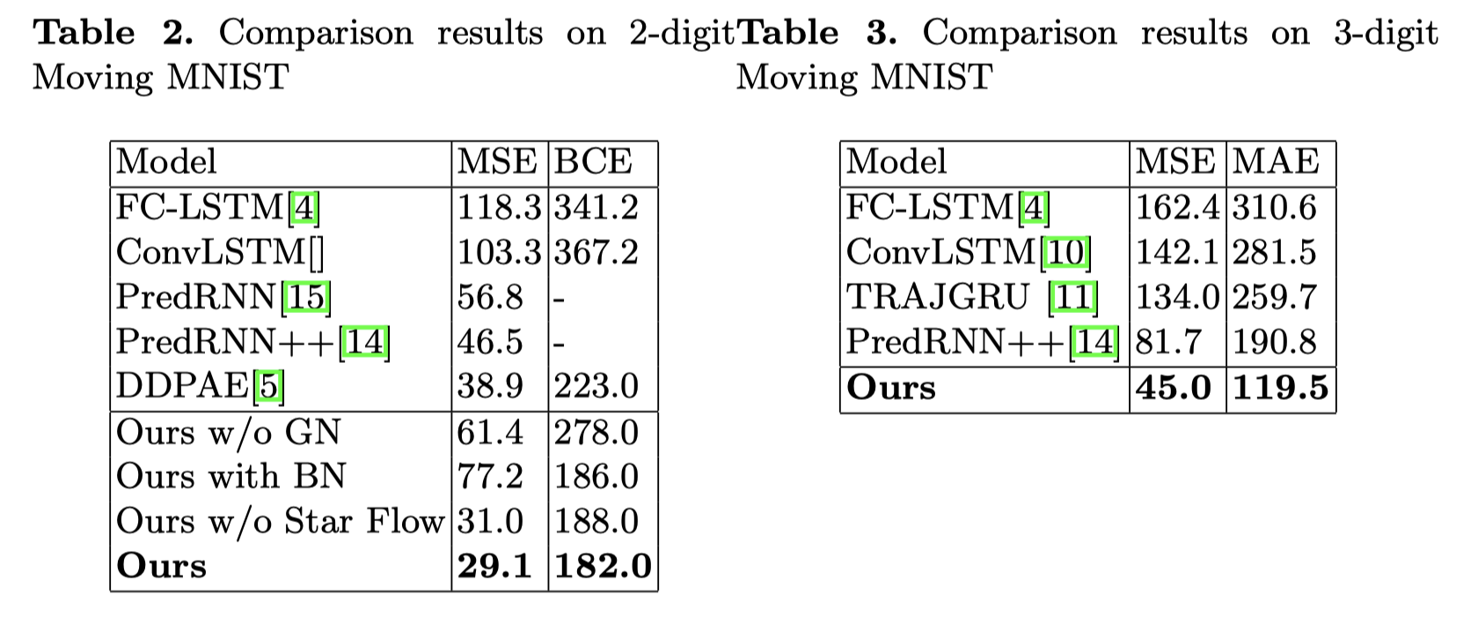
Quality Metrics
Notes:
concatenate output of all ConvLSTM layers and pass it to a 1 × 1 convolution layer and split the output of convolution layer to all ConvLSTM layers of next time-step by a residual connection to their inputs

Slide 25
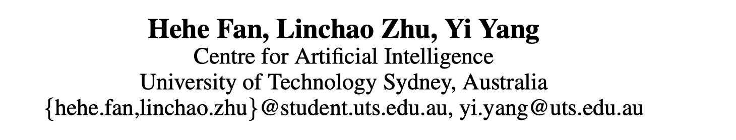
Cubic LSTMs for Video Prediction
Notes:
the initial states and cell outputs of the forecasting network are copied from the last state of the encoding network.
最后1*1 卷积 得到final prediction
-5x5’ and ‘-1x1’ represent the corresponding state-to-state kernel size, which is either 5×5 or 1×1. ‘256’, ‘128’, and ‘64’ refer to the number of hidden states in the ConvLSTM layers. ‘(5x5)’ and ‘(9x9)’ represent the input-to-state kernel size.

Slide 26
Cubic --Three branches:
The temporal branch ﬂows along the x-axis (temporal axis), on which the convolution aims to obtain and process motions.
The spatial branch ﬂows along the z-axis (spatial axis), on which the convolution is responsible for capturing and analyzing moving objects.
The output branch generates intermediate or ﬁnal prediction frames along the y-axis (output axis), according to the predicted motions provided by the temporal branch and the moving object information provided by the spatial branch.

Slide 27
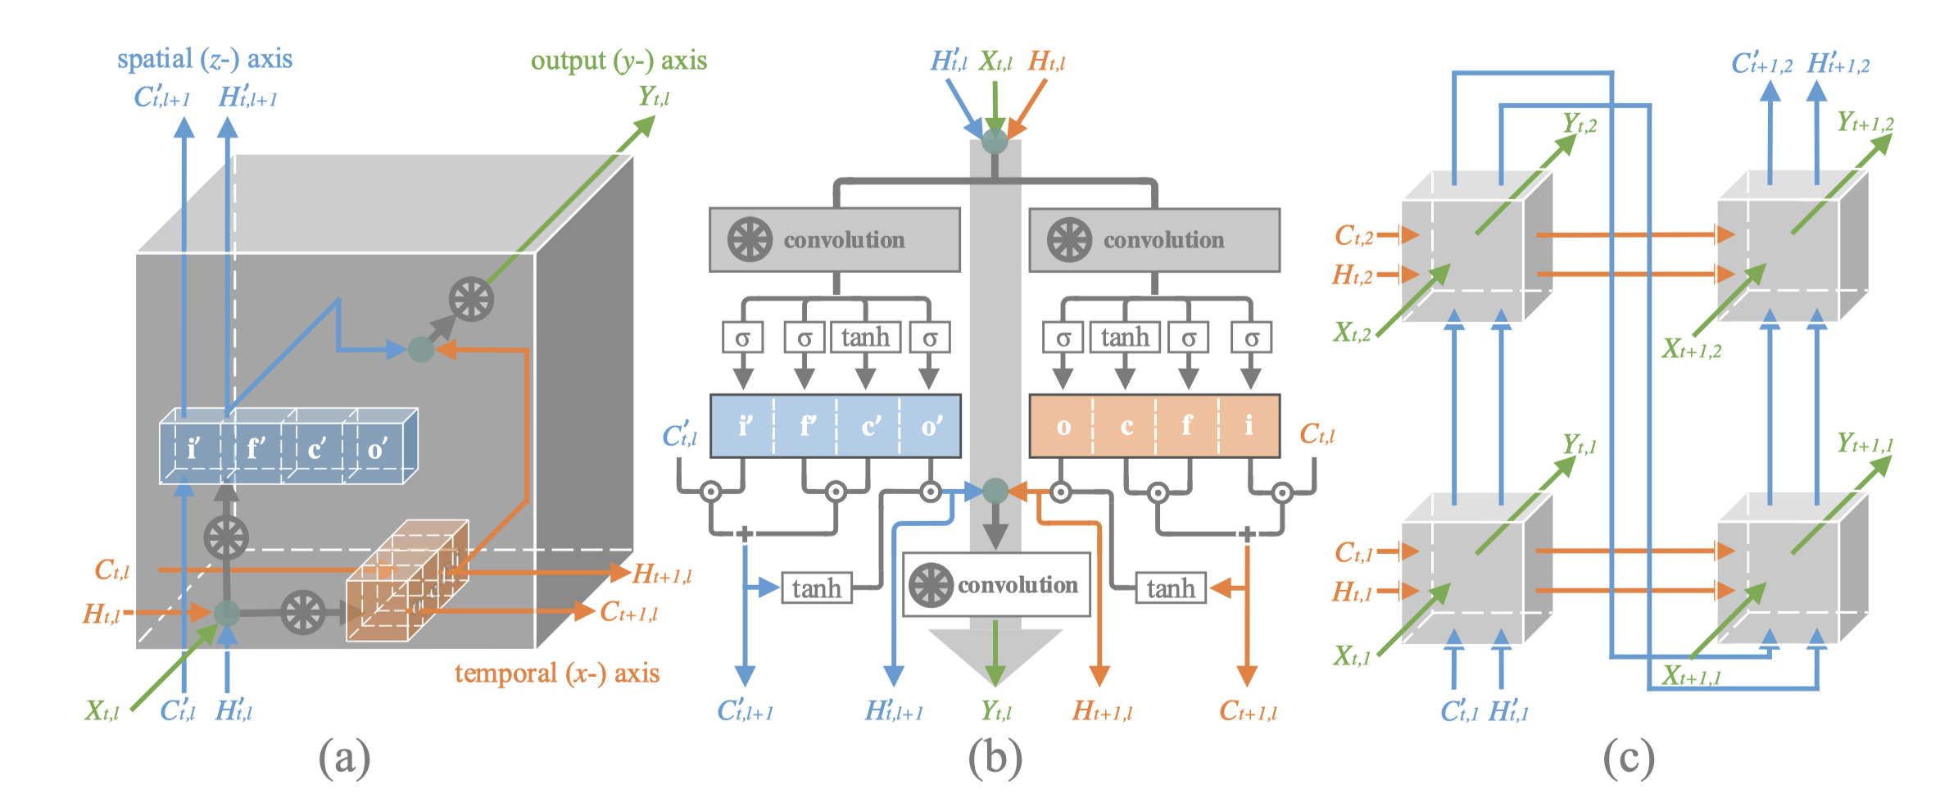
Model

Slide 28
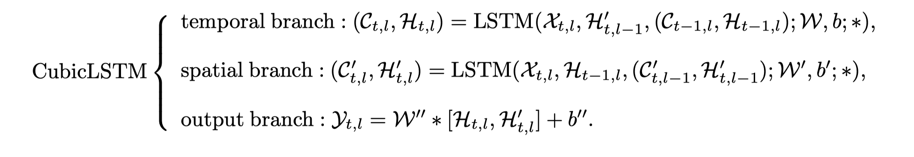
The updates for Cubic LSTM units

Slide 29
Experiments
Data set: Moving MNIST
Kernel size:
Spatial branch: 5 × 5.
Temporal and Output Branch: 1 × 1.
Reason: ‘Motion’ should focus on temporal neighbors while ‘object’ should focus on spatial neighbors.

Slide 30
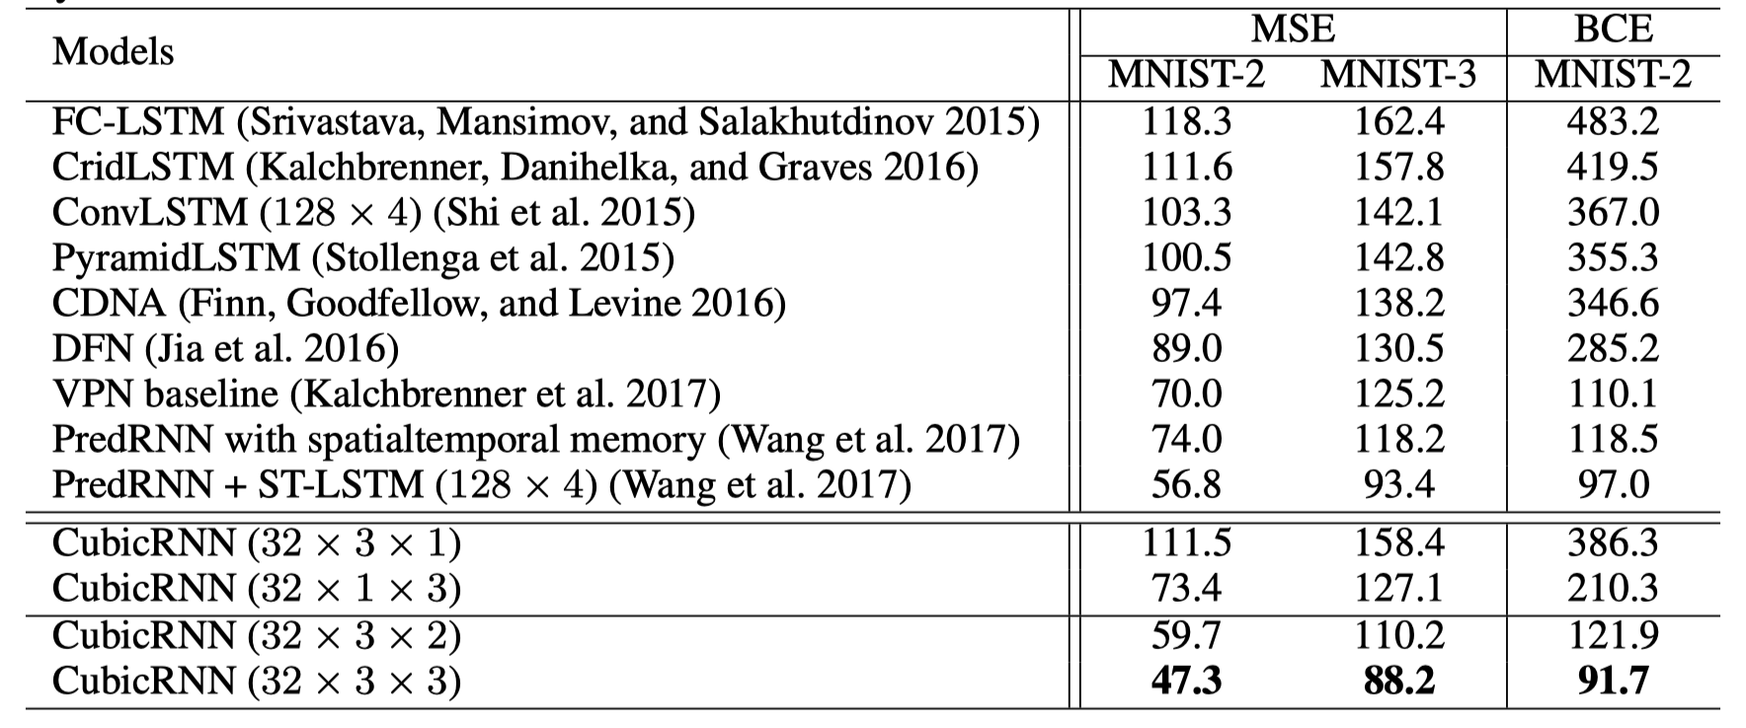
Quality Metrics

Slide 31

Predicting Future Frames using Retrospective Cycle GAN
Notes:
the initial states and cell outputs of the forecasting network are copied from the last state of the encoding network.
最后1*1 卷积 得到final prediction
-5x5’ and ‘-1x1’ represent the corresponding state-to-state kernel size, which is either 5×5 or 1×1. ‘256’, ‘128’, and ‘64’ refer to the number of hidden states in the ConvLSTM layers. ‘(5x5)’ and ‘(9x9)’ represent the input-to-state kernel size.

Slide 32
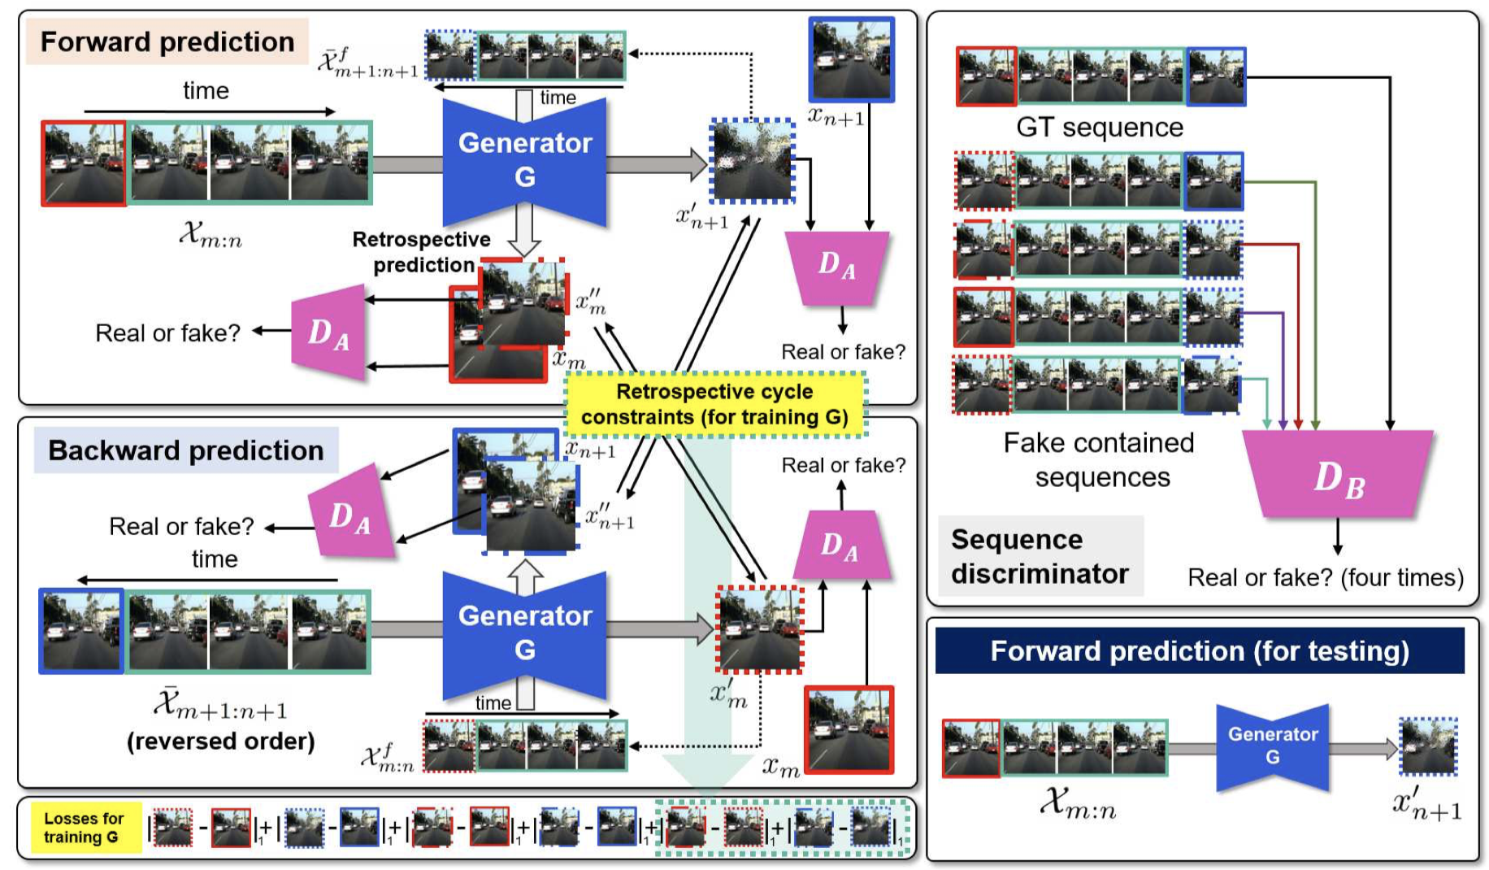
Model
Retrospective
Cycle GAN
One Generator
Two Discriminator

Slide 33
Model
Generator: 4 Convolution layers, 9 Residual blocks, 2 transpose convolution layers
Discriminator: 5 convolution layers with leaky rectified linear units.

Slide 34
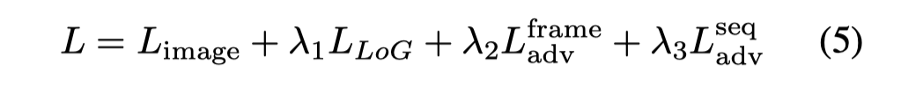
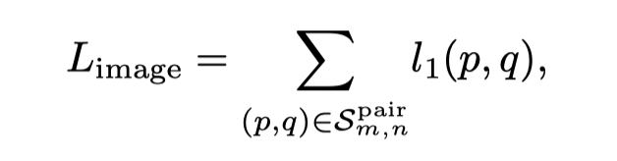
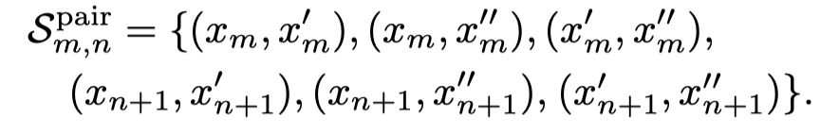
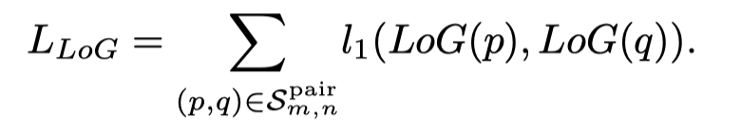
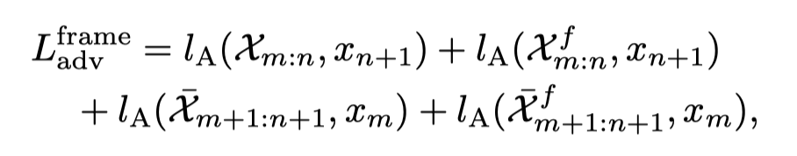
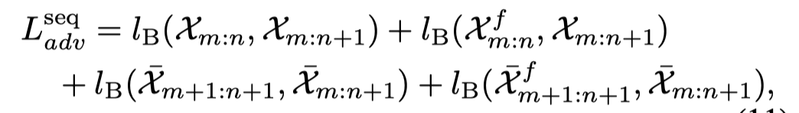
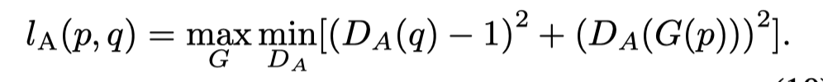
Loss
Two sequence:
(1)
(2)
Notes:
1. are used to minimize prediction errors in forward m and backward directions.
2. are retrospective prem diction errors.
3. take the role of cyclic constraints.
LOG: Laplacian of Gaussian

Slide 35
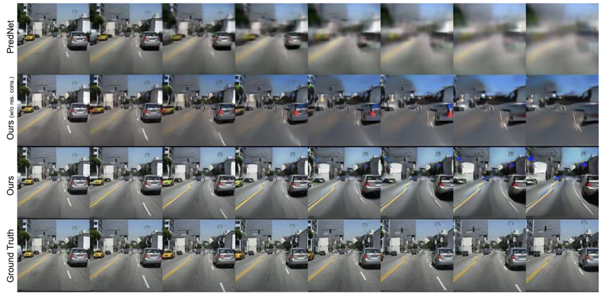
Experiments
Notes:
1. are used to minimize prediction errors in forward m and backward directions.
2. are retrospective prem diction errors.
3. take the role of cyclic constraints.

Slide 36
Thank you!

